Slide 1


A CROSS-SECTIONAL STUDY OF ANALYSIS OF CARDIOVASCULAR DISEASE BASED ON HEALTH INDICATORS
Guided By
Dr. Zeyana Hamid, PhD, MHI/MHA
Lecturer, Dept. of BioHealth Informatics School of
Informatics and Computing, IUPUI
Team 7
Deepishka Pemmasani Surya Tejaswi Mallidi
Poorva Reddy Vanga Raajitha Muthyala Daniel Adepoju

Slide 2

OVERVIEW
Cardiovascular diseases (CVD) are a significant public health concern, contributing to a substantial burden of morbidity and mortality worldwide. Risk factors for CVD include smoking, diabetes, obesity, and hypertension, which account for about 50% of the pathogenesis of CVD. Treatment of these risk factors has been shown to reduce the risk of future cardiac events (Acevedo et al., 2021). Identifying significant health indicators associated with cardiovascular disease can help in the prevention, diagnosis, and treatment of the disease. Understanding the prevalence and determinants of CVD risk factors is crucial for developing effective interventions to reduce the burden of CVD.

Slide 3
Aim: To identify significant health indicators associated with cardiovascular disease and to develop predictive machine learning models to predict the presence of cardiovascular disease based on these indicators.
Purpose: To Conduct a cross-sectional study to analyze the health screening dataset and to understand the relationship between various health indicators and the presence of cardiovascular disease.

Slide 4
Research Questions:
1. What are the significant health indicators associated with cardiovascular disease in the given health screening dataset?
2. How do various health indicators, relate to the presence of cardiovascular disease?
3. Can predictive machine learning models be developed to accurately predict the presence of cardiovascular disease based on the identified health indicators in the dataset?

Slide 5



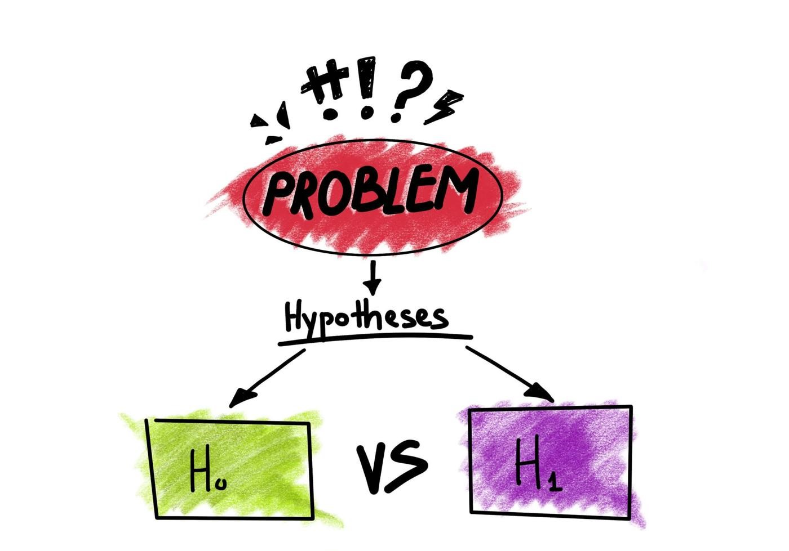
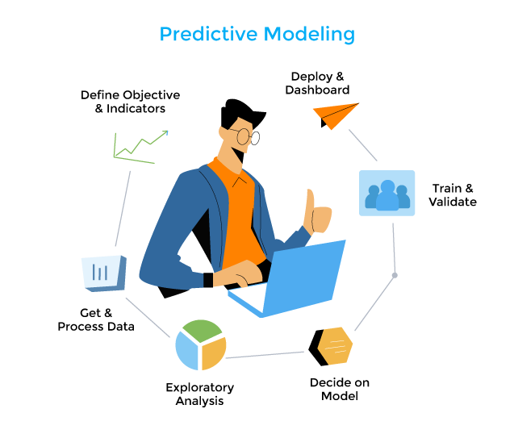
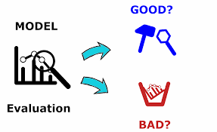
Methodology:
1. Data import
2. Data Cleaning
3. Statistical Analysis
4. Hypothesis testing
5. Development of predictive machine learning models
6. Evaluation of Predictive models
Notes:
Data Import: The health screening dataset was imported into python Jupiter notebook.
Data Cleaning: The dataset was cleaned to handle missing values, outliers and any inconsistencies of the data.
Statistical Analysis: Descriptive statistics will be used to summarize the characteristics of the dataset, and inferential statistics may be used to identify relationships between variables.
Hypothesis Testing: Hypothesis tests was conducted to determine if there are significant differences in health indicators between individuals with and without cardiovascular disease.
5. Development of Predictive Machine Learning Models: Machine learning models, such as logistic regression, decision trees, random forests, and support vector machines, were developed to predict the presence of cardiovascular disease based on the health indicators in the dataset.
6. Evaluation of Predictive Models: The predictive models were evaluated using appropriate metrics, such as accuracy, precision, recall, and F1 score, to determine their performance.

Slide 6
Hypothesis
Null Hypothesis (H0): There is no significant relationship between the health parameters (age, gender, blood pressure, BMI, cholesterol level, smoking, alcohol consumption, physical activity etc.) and the risk of cardiovascular disease (CVD) in the study population.
Alternative Hypothesis (H1): There is a significant relationship between the health parameters (age, gender, blood pressure, BMI, cholesterol level, smoking, alcohol consumption, physical activity etc.) and the risk of cardiovascular disease (CVD) in the study population.

Slide 7
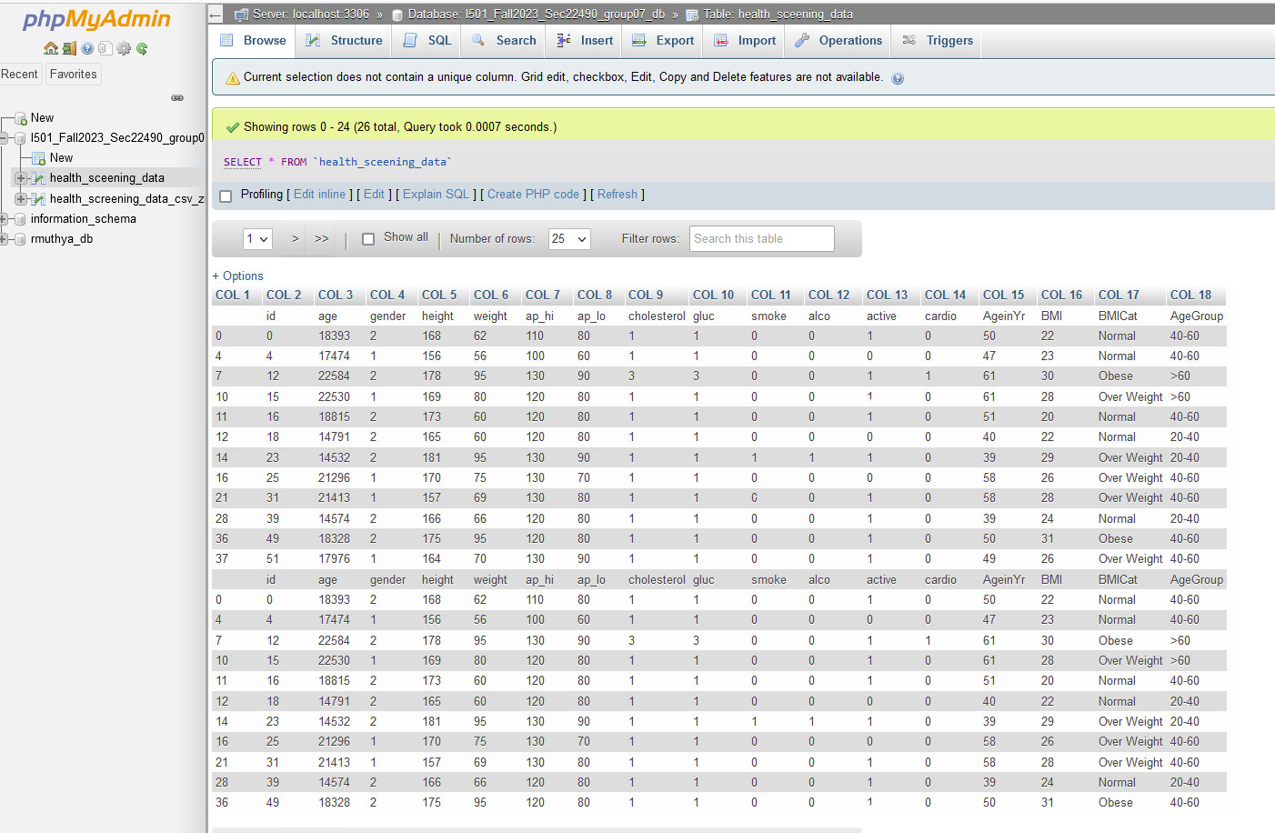

Slide 8
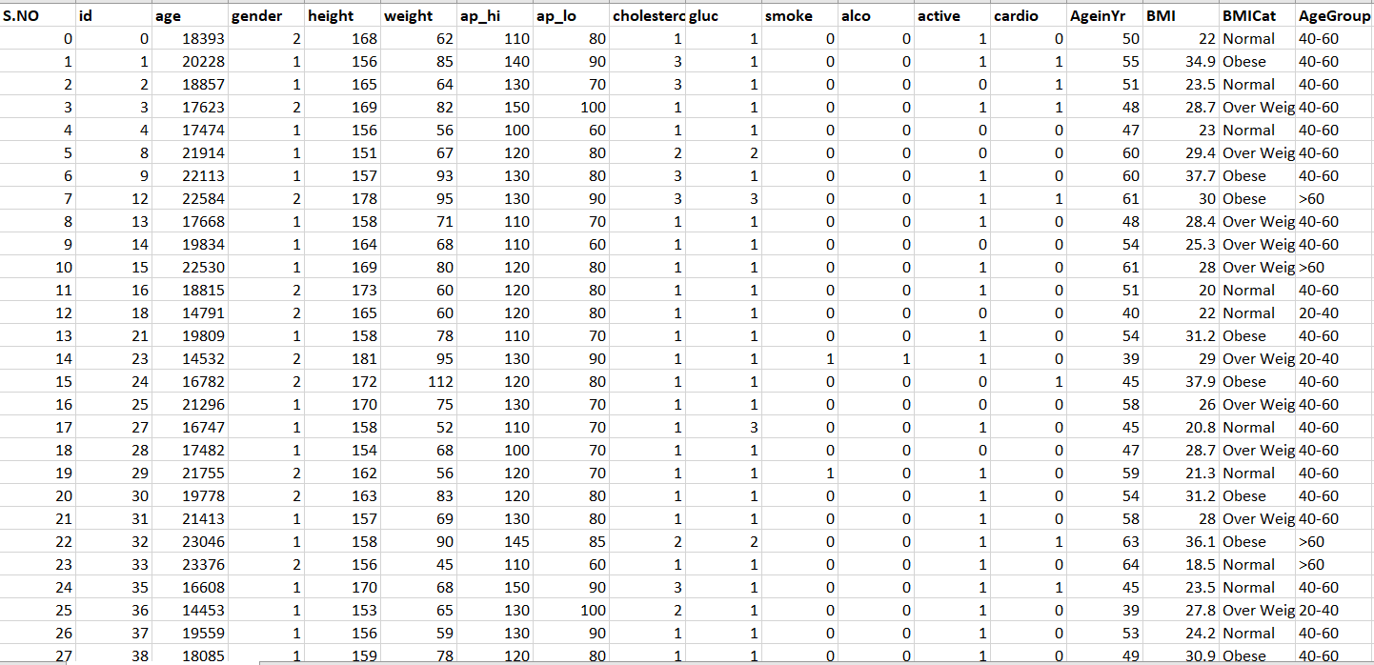
HEALTH SCREENING DATA SET
https://www.kaggle.com/datasets/drateendrajha/health-screening-data

Slide 9
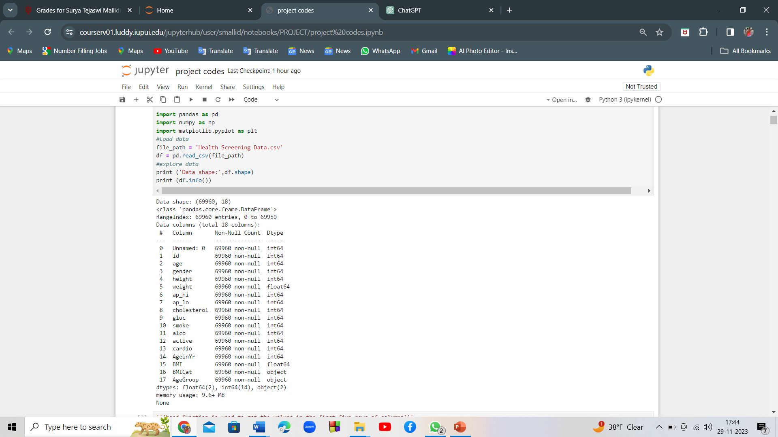
IMPORT AND EXPLORING THE DATA SET
We have imported the dataset and assigned it to pandas data frame named df.
We have used Shape function to identify the total number of rows and columns.

Slide 10
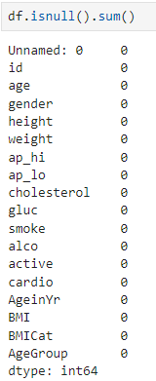
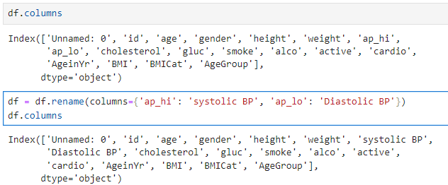
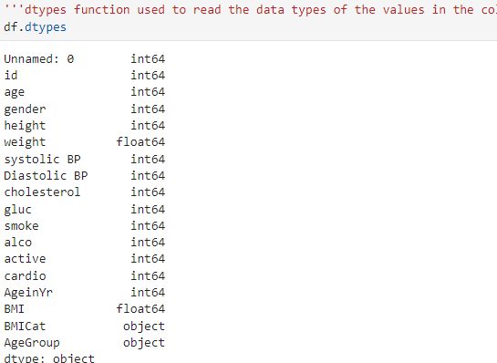
DATA CLEANING
The dataset did not have any missing values.
The columns were renamed for better understanding of the data
The columns BMI Cat and Age Group had non-numerical values and the columns gender, cholesterol, gluc, smoke, alcohol, active, cardio have categorical values.

Slide 11

EXPLORATORY DATA ANALYSIS

Slide 12
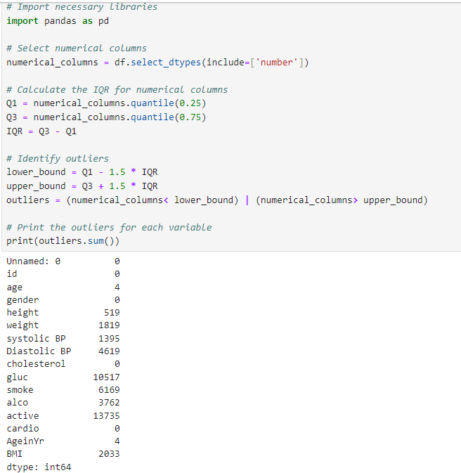
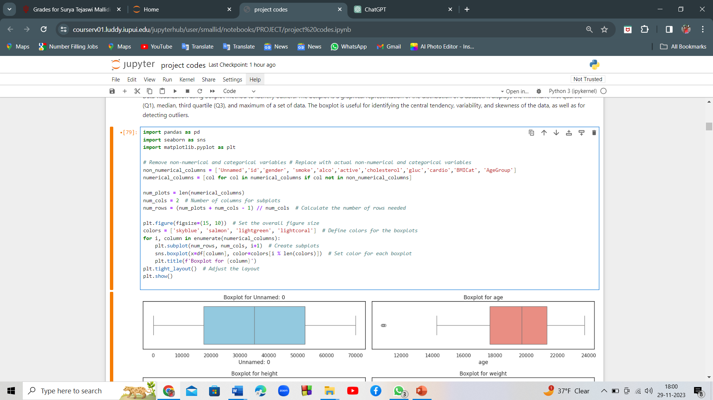
TESTING OUTLIERS
Notes:
Outliers are data points that significantly differ from the rest of the data, and they can have a substantial impact on the results of statistical analyses and machine learning models. Therefore, it is crucial to identify and handle outliers appropriately.
Common techniques for identifying and handling outliers in data analysis include: Visualizing the data: Box plots, histograms, and scatter plots can help identify outliers visually.
The boxplot is a graphical representation of the distribution of a dataset. It displays the minimum, first quartile (Q1), median, third quartile (Q3), and maximum of a set of data. The boxplot is useful for identifying the central tendency, variability, and skewness of the data, as well as for detecting outliers.

Slide 13
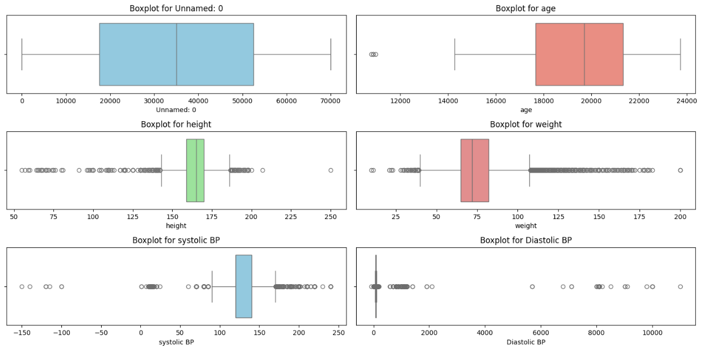
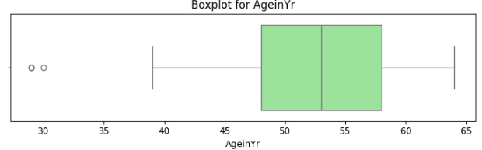
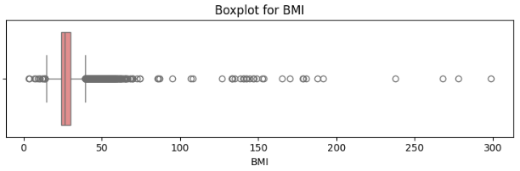
Visualization of outliers using box plot
Notes:
Data visualization using Boxplot method to identify outliers: The boxplot is a graphical representation of the distribution of a dataset. It displays the minimum, first quartile (Q1), median, third quartile (Q3), and maximum of a set of data. The boxplot is useful for identifying the central tendency, variability, and skewness of the data, as well as for detecting outliers.

Slide 14
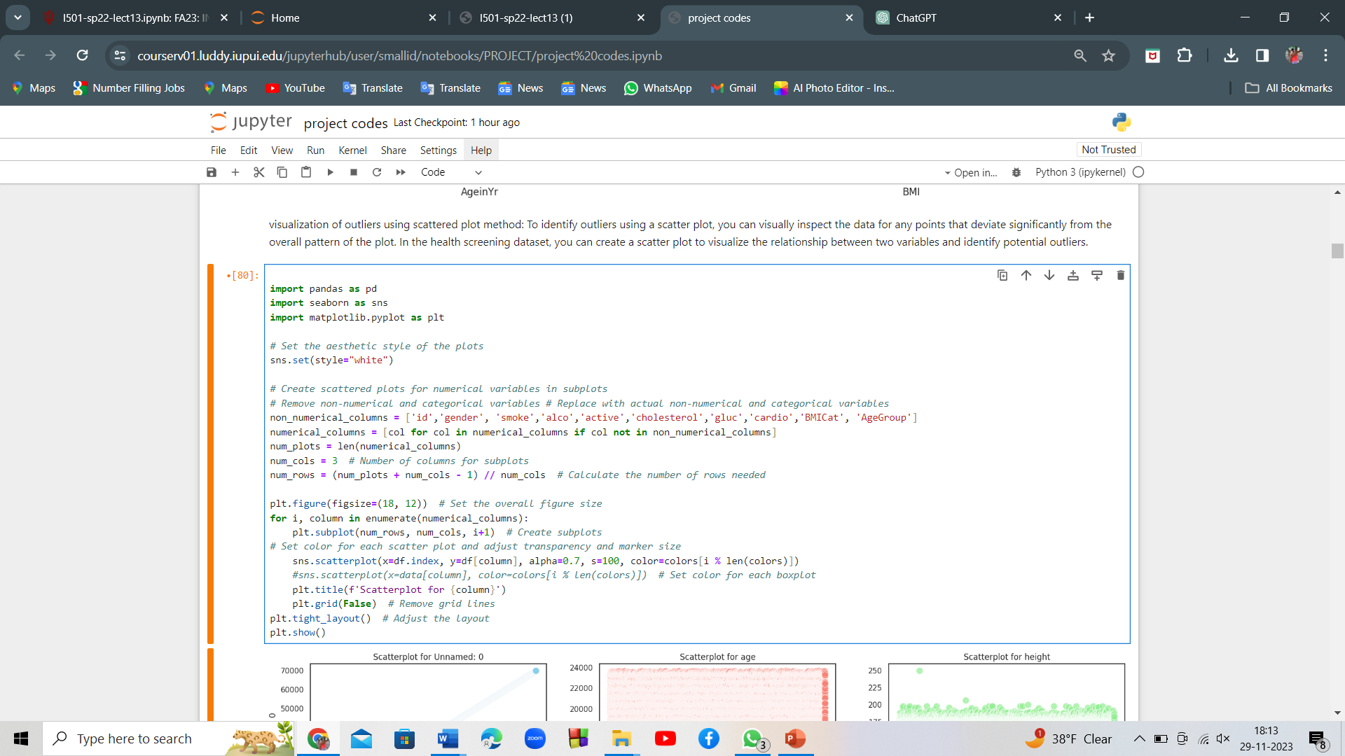
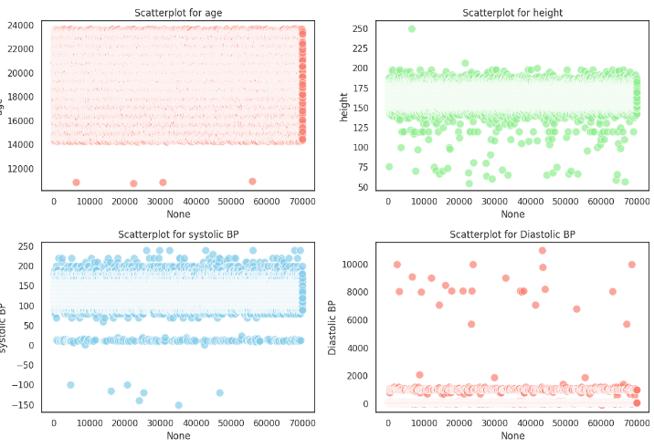
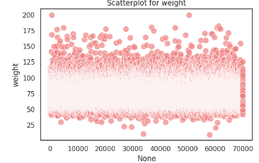
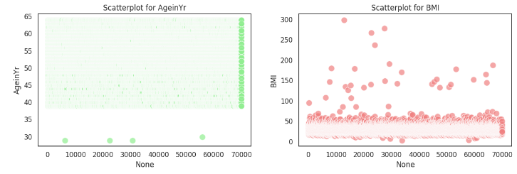
Visualization of outliers using scatter plot
Notes:
Visualization of outliers using scattered plot method: To identify outliers using a scatter plot, you can visually inspect the data for any points that deviate significantly from the overall pattern of the plot. In the health screening dataset, you can create a scatter plot to visualize the relationship between two variables and identify potential outliers.

Slide 15
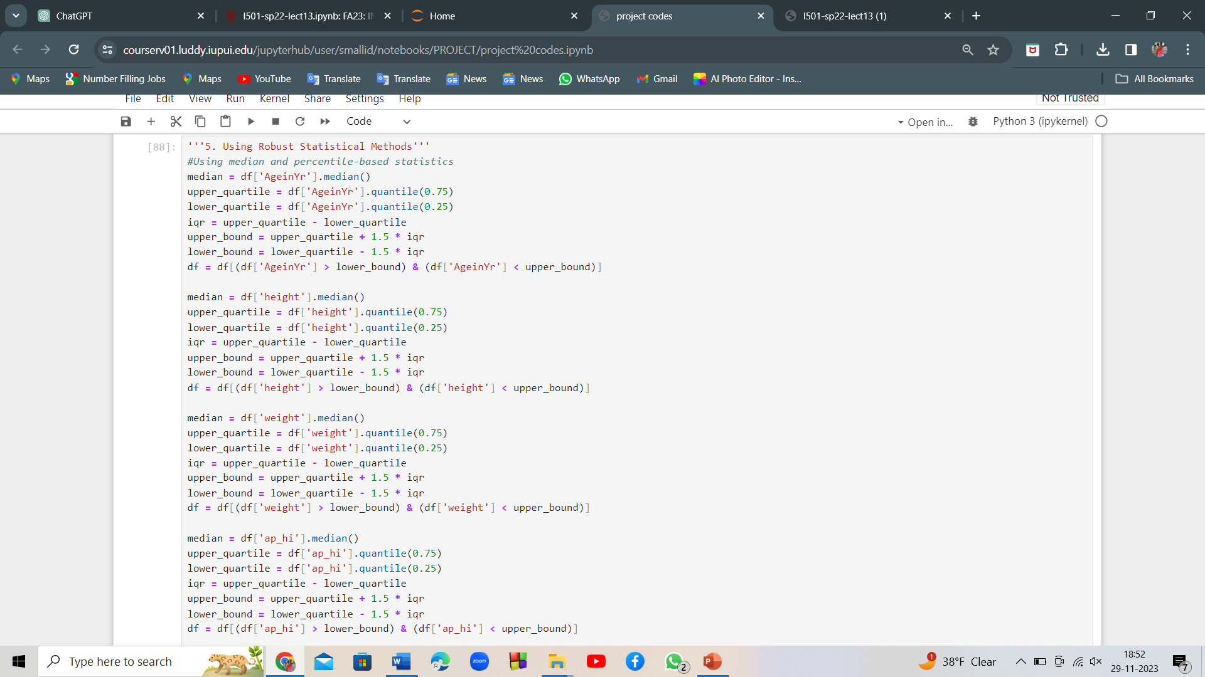
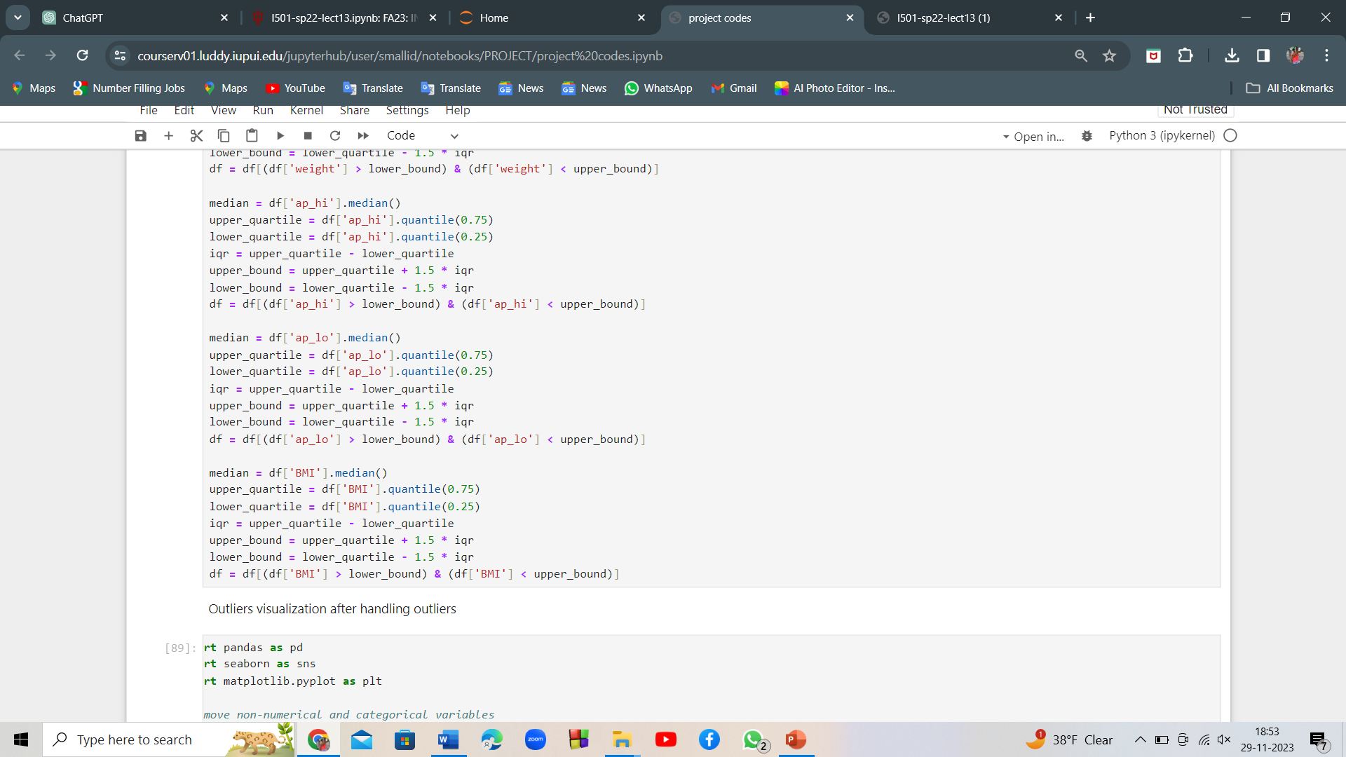
HANDLING OF OUTLIERS
We have handled the outliers by imputing them with central tendencies, binning, and using robust statistical methods.

Slide 16
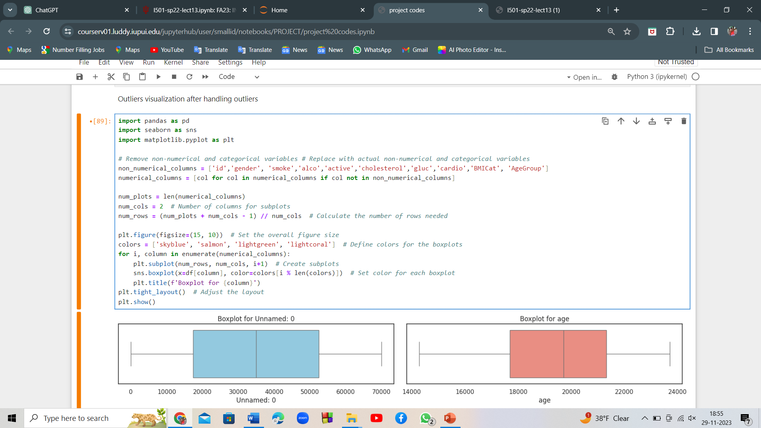
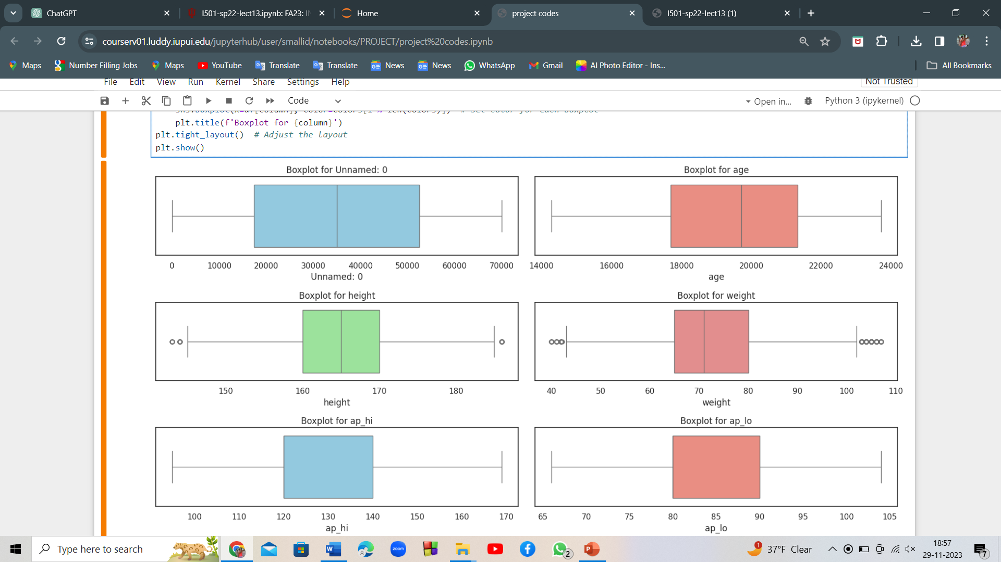
VISUALIZATION AFTER HANDLING OUTLIERS

Slide 17
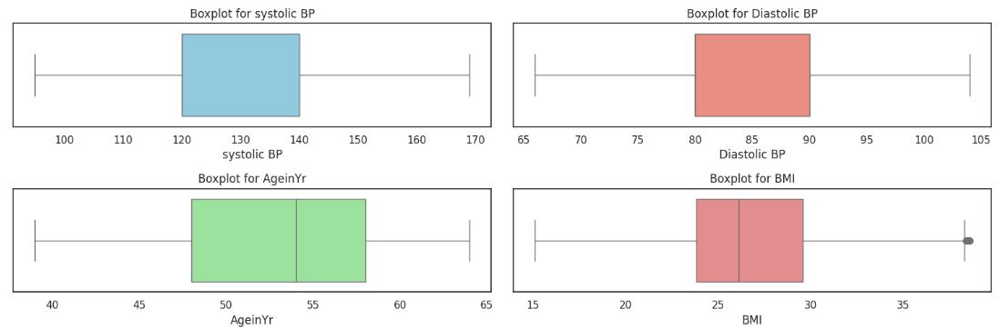
CONT.....

Slide 18
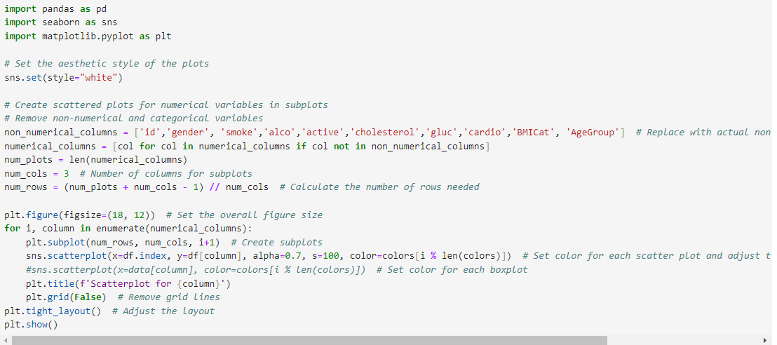
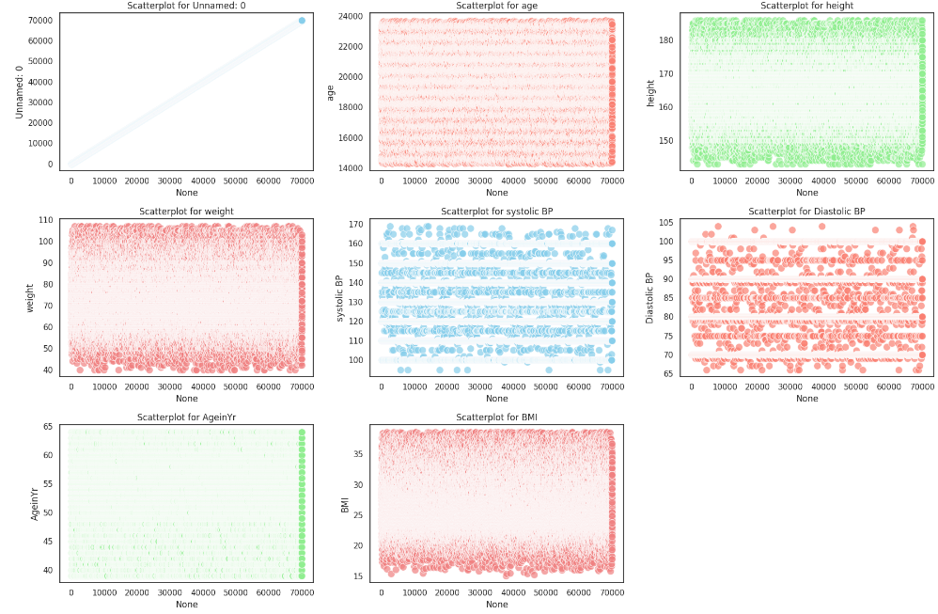
Outlier visualization using scatter plot

Slide 19
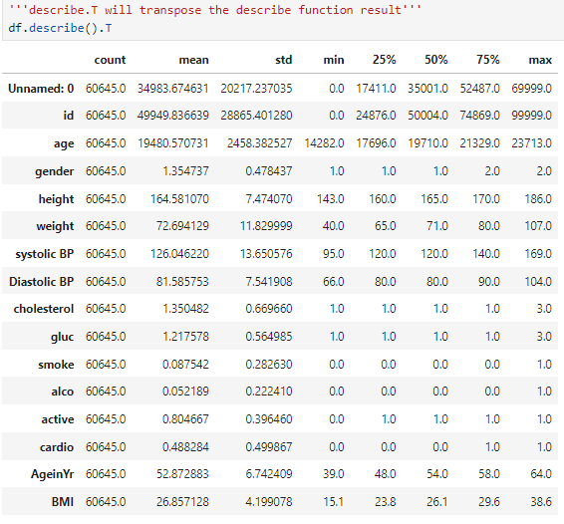
Descriptive statistics of the data after handling outliers
Notes:
The mean age of the individuals in the dataset is approximately 52.87 years, with a standard deviation of 6.74 years. The age ranges from 39 to 64 years.
The mean BMI (Body Mass Index) is around 26.86, with a standard deviation of 4.20. The BMI values range from 15.1 to 38.6.
The mean systolic blood pressure is approximately 126.05 mmHg, with a standard deviation of 13.65 mmHg. The values range from 95.0 to 169.0 mmHg.
The mean diastolic blood pressure is about 81.59 mmHg, with a standard deviation of 7.54 mmHg. The values range from 66.0 to 104.0 mmHg.
The prevalence of smoking and alcohol consumption is relatively low in the dataset, with mean values of 0.088 and 0.052, respectively.
The mean cholesterol level is approximately 1.35, and the mean glucose level is around 1.22.
The mean height is 164.58 cm, and the mean weight is 72.69 kg.

Slide 20
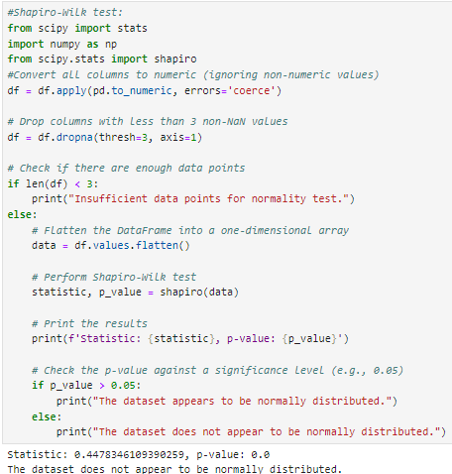
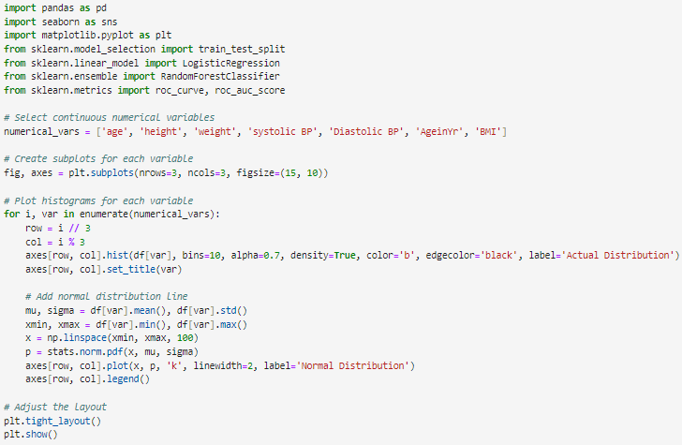
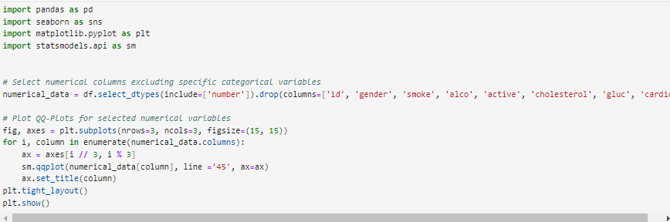
Normality Testing
We performed Shapiro-Wilk test, histogram and Q-Q plots to assess the distribution of the data.
Notes:
The normality test in data analysis is a statistical method used to determine if a given dataset follows a normal distribution. A normal distribution, also known as a Gaussian distribution, is characterized by a symmetric, bell-shaped curve.
The test provides a p-value, and if the p-value is less than a chosen significance level (e.g., 0.05), the null hypothesis that the data is normally distributed is rejected.

Slide 21
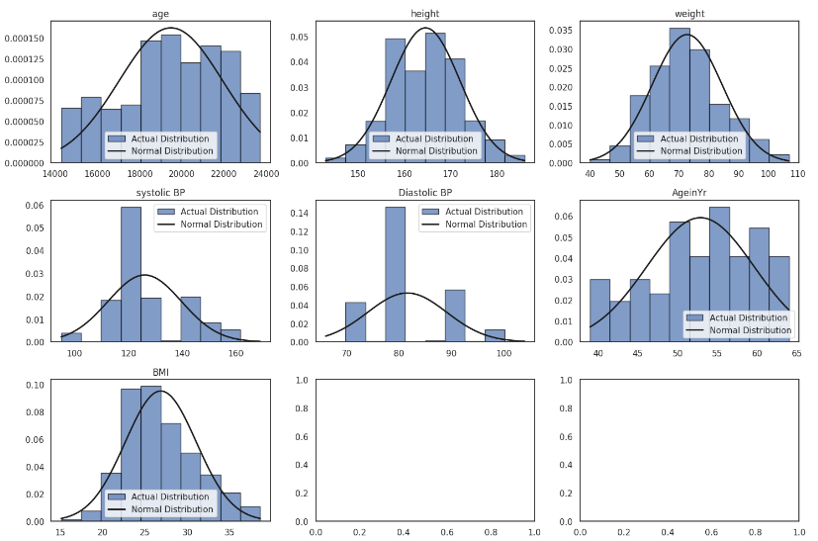
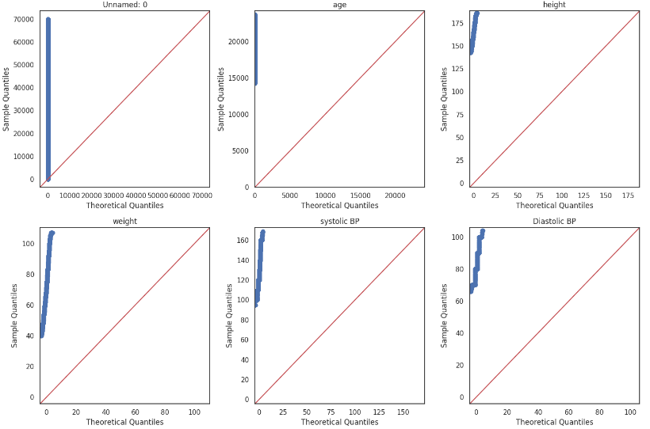
Normality testing contd..
Notes:
Visual Inspection: Plotting histograms, Q-Q plots, or density plots of the data can provide a visual indication of whether the data is approximately normally distributed. A bell-shaped curve in the histogram suggests normality.
while histograms can provide an initial indication of normality, they have limitations, especially with small sample sizes.
Normal probability plots, also known as Q-Q (quantile-quantile) plots, are a better choice for assessing normality. A straight line in the Q-Q plot suggests normal distribution of the data.

Slide 22
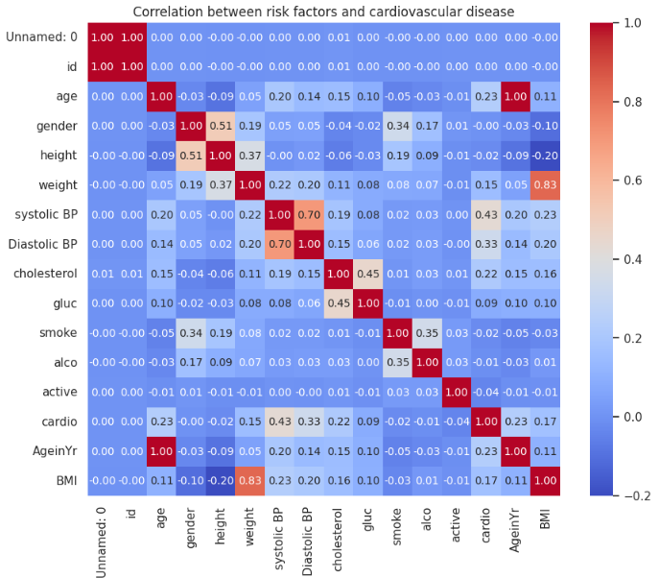
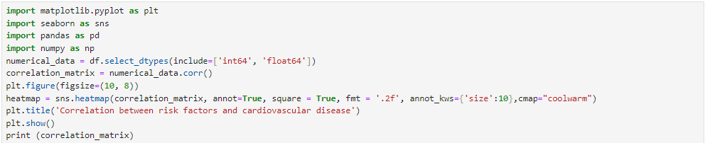
Relationship analysis between variables – Correlation matrix
Cardio has a moderate positive correlation with age, systolic blood pressure, and diastolic blood pressure. This suggests that as age and blood pressure increase, the likelihood of cardiovascular disease also tends to increase.
Cardio also has a positive correlation with BMI, indicating that higher BMI is associated with a higher likelihood of cardiovascular disease.
There is a weak positive correlation between cardio and weight, cholesterol, and gluc (glucose).
Notes:
A correlation matrix is a statistical tool that shows how strong and in what direction two or more variables are related. It is used to evaluate the relationship between variables in a data set.
The correlation coefficient is a number between -1 and 1, where 1 indicates a strong positive relationship, -1 indicates a strong negative relationship, and 0 indicates no relationship.
Insights from correlation matrix:
Age is positively correlated with systolic blood pressure, diastolic blood pressure, cholesterol, and BMI. This suggests that as age increases, these variables also tend to increase.
Gender has a moderate positive correlation with height and a weak positive correlation with weight. This indicates that, on average, men tend to be taller and heavier than women in the dataset.
Systolic blood pressure is positively correlated with age, weight, and BMI. This is expected, as higher weight and BMI are often associated with higher blood pressure.
Diastolic blood pressure shows a similar pattern of correlation as systolic blood pressure, with positive correlations with age, weight, and BMI.
Cholesterol and gluc (glucose) are positively correlated, which is expected as both are related to metabolic health.
Smoking and alcohol consumption (smoke and alco) have weak positive correlations with gender, indicating that, on average, men are more likely to smoke and consume alcohol in the dataset.
Cardio (presence of cardiovascular disease) is positively correlated with age, systolic and diastolic blood pressure, and BMI. This suggests that these variables are associated with a higher likelihood of cardiovascular disease.
BMI is strongly positively correlated with weight, which is expected as BMI is calculated using weight and height.
This suggests that these variables may also be associated with a higher likelihood of cardiovascular disease, but the relationship is not as strong as with age, blood pressure, and BMI.

Slide 23
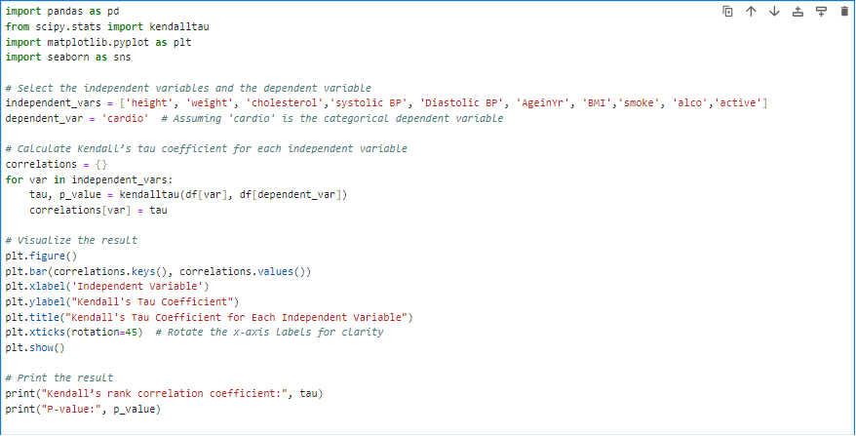
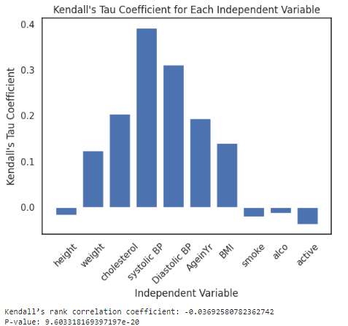
Kendall’s Rank and Spearman’s Correlation tests:
To identify the strength and direction of monotonic association between independant and dependant variables, and to determine the correlation coefficient, we performed Kendall’s Rank and Spearman’s Correlation tests.
Notes:
The Kendall (1955) rank correlation coefficient evaluates the degree of similarity between two sets of ranks given to a same set of objects. Spearman's rank correlation measures the strength and direction of association between two ranked variables.

Slide 24
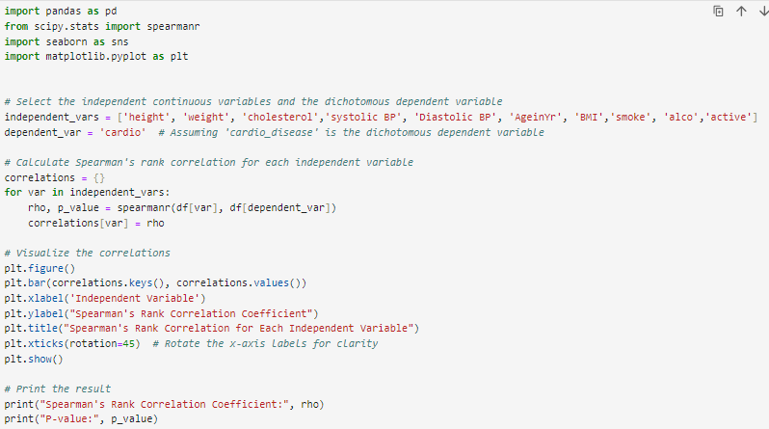
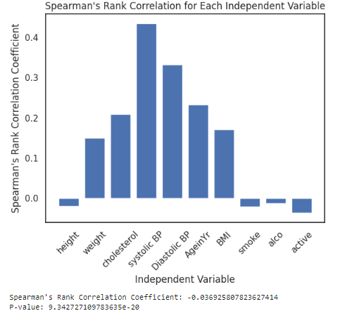
Both Kendall’s tau and Spearman’s rho (the coefficient is close to 0) indicate a moderate positive rank correlation between the variables being tested, and the low p-values (9.60e-20 and 9.34e-20) suggest that these correlations are statistically significant.
This suggests a very weak, but statistically significant, negative relationship between variables analyzed. While the correlation is significant, the strength of the relationship is very low, indicating that the variables are not strongly related in terms of their ranks.

Slide 25
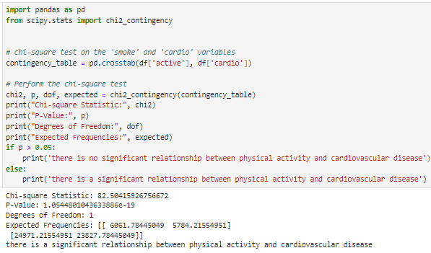
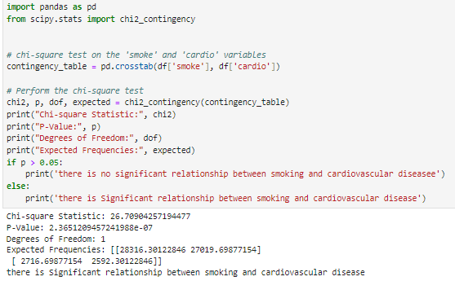
As the data is not normally distributed, we have performed non-parametric tests.
Chi-Square test:
We have used Chi-square test to test the association between variables.

Slide 26
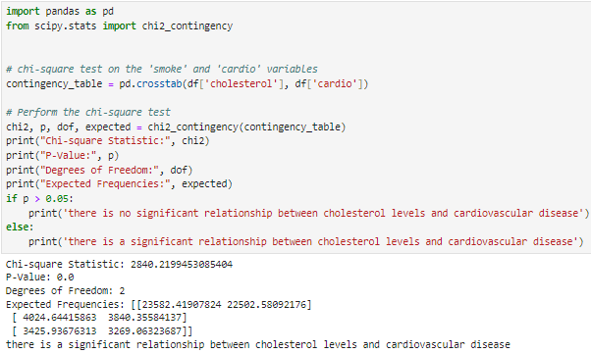
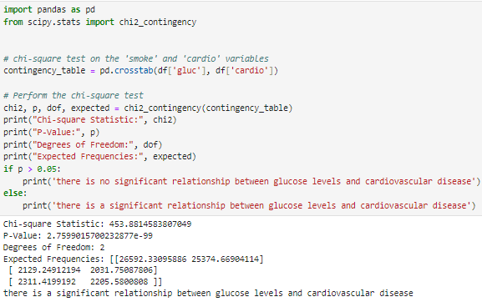
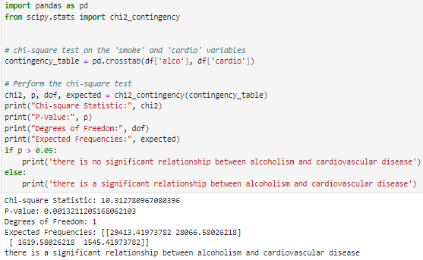
Chi-square test contd..
Notes:
Based on the nature of the dependant variable (categorical, dichotomous) in the dataset, we couldn’t perform Mann Whitney U test, Kruskal Wallis Test, Wilcoxon Signed Rank test on our dataset.

Slide 27
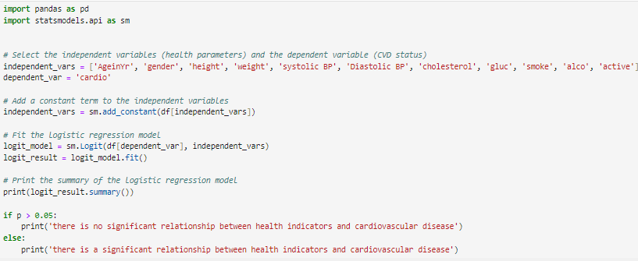
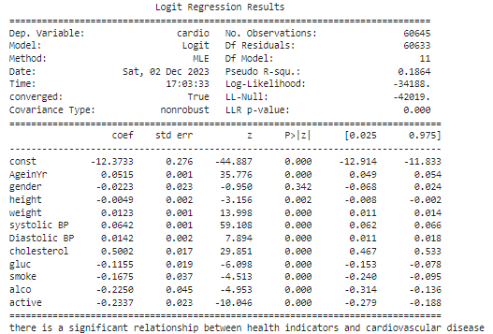
Logistic Regression:
Logistic regression was used to predict the association of health indicators with the cardiovascular disease.
The logistic regression results showed that included health indicators are significantly associated with the presence of cardiovascular disease.
Notes:
The direction and magnitude of the coefficients provide information about the strength and nature of these relationships, and the model fit suggests that the included variables explain a moderate amount of the variance in the presence of cardiovascular disease.
Significant Variables:
The coefficients of the variables "AgeinYr", "height", "weight", "systolic BP", "Diastolic BP", "cholesterol", "gluc", "smoke", "alco", and "active" are all statistically significant (P < 0.05). This suggests that these variables are associated with the presence of cardiovascular disease.
Effect Direction:
The positive coefficients (e.g., "systolic BP", "Diastolic BP", "cholesterol") indicate that an increase in these variables is associated with a higher likelihood of cardiovascular disease, while the negative coefficients (e.g., "gluc", "smoke", "alco", "active") suggest a lower likelihood of cardiovascular disease with an increase in these variables.
Magnitude of Effect:
The magnitude of the coefficients provides information about the strength of the relationship between the independent variables and the presence of cardiovascular disease. For example, "systolic BP" has a relatively large coefficient (0.0642), indicating a stronger effect compared to other variables.
Model Fit:
The Pseudo R-squared value of 0.1864 suggests that the model explains approximately 18.64% of the variance in the presence of cardiovascular disease. It indicates that there are other factors not accounted for in the model.

Slide 28

DATA VISUALIZATION

Slide 29
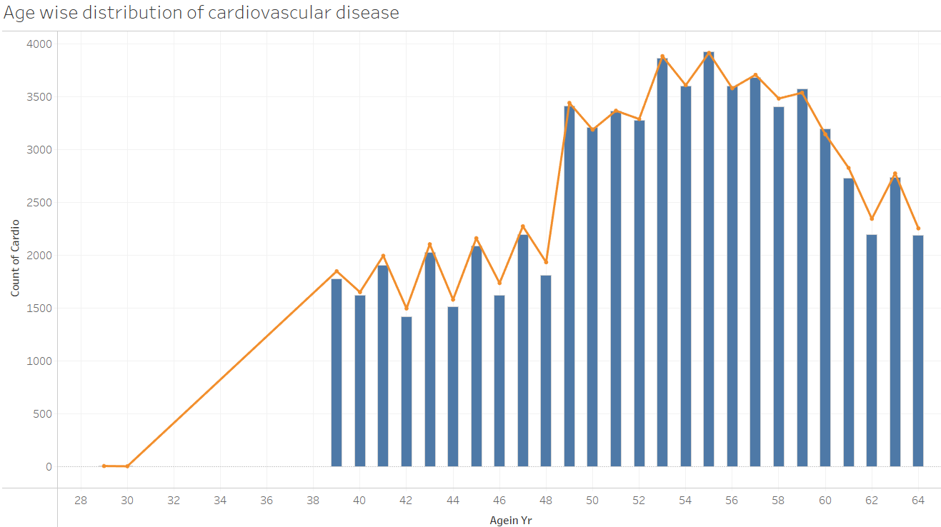
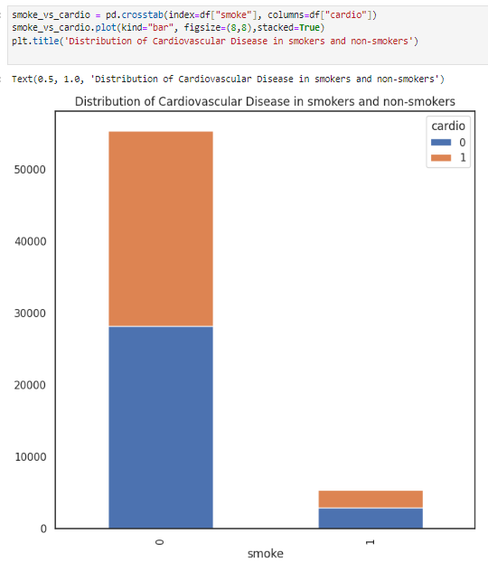
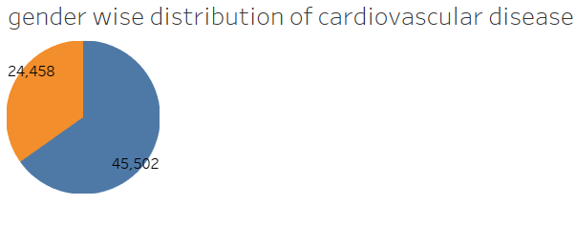
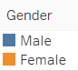
The age group of 50 to 60 years showed high cardiovascular disease in the dataset
Males have high incidence of cardiovascular disease compared to females in the dataset.
The above figure shows there is high distribution of cardiovascular disease in non-smokers compared to smokers

Slide 30
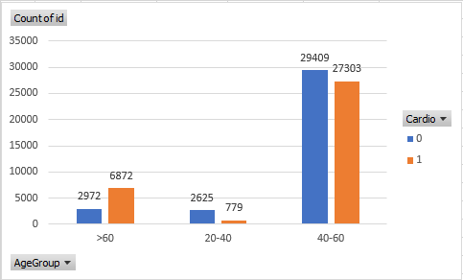
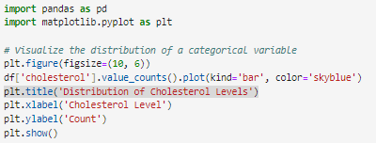


Age wise and gender wise distribution is visualized by these 2 figures

Slide 31


Obese people with BMI from 30 to 40 showed greater incidence of cardiovascular disease
The population between 50 to 60 years showed high cardiovascular disease

Slide 32


The people with pre-hypertension (systolic BP 135 and above and diastolic BP 85 and above) showed higher incidence of cardiovascular diseases.

Slide 33



People with higher cholesterol levels showed high cardiovascular disease risk
No significant difference observed in cardiovascular disease based on physical activity

Slide 34

PREDICTIVE MODELING TECHNIQUES TO EVALUATE THE SIGNIFICANCE OF THE RELATIONSHIP BETWEEN THE HEALTH PARAMETERS AND CVD RISK

Slide 35

Preprocessing the data:
In the below code, we preprocessed the data it by splitting it into training and testing sets and performing feature scaling. After that, we trained the logistic regression, decision tree, random forest, and support vector machine models and evaluate their performance using metrics of accuracy, precision, recall, and F1 score.
Notes:
The health screening dataset contains various features such as age, gender, height, weight, blood pressure, cholesterol level, glucose level, smoking status, alcohol intake, physical activity, and the presence of cardiovascular disease. Given the nature of the dataset, several machine learning models can be used for analysis, including logistic regression, decision trees, random forests, and support vector machines (SVM).
Preprocess the data by handling missing values, encoding categorical variables, and scaling the features if necessary.

Slide 36


Logistic regression:
Notes:
It is widely used for binary classification tasks, such as predicting the presence of a disease based on health screening data. Logistic regression models the probability of a binary outcome based on one or more predictor variables.

Slide 37


Decision tree model:
Notes:
Decision trees are used to understand the most important features for predicting health conditions. They are easy to interpret and can handle both numerical and categorical data.

Slide 38

Random forest Model:
Notes:
Random forests are an ensemble learning method that can be used for classification tasks in health screening datasets. They are robust to overfitting and can handle large datasets with high dimensionality.

Slide 39

Support vector machine model:
Notes:
SVMs are effective for binary classification tasks, including predicting the presence of a disease based on health screening features. They work well in high-dimensional spaces and are effective when the number of samples is less than the number of dimensions.

Slide 40

Evaluating the model performance:
Notes:
Accuracy: It measures the proportion of correctly predicted instances out of the total instances. The Support Vector Machine model has the highest accuracy of 0.726358, followed by Logistic Regression with an accuracy of 0.722648.
Precision: It measures the proportion of true positive predictions out of the total positive predictions. The Support Vector Machine model also has the highest precision of 0.762964, indicating its ability to avoid false positives.
Recall: It measures the proportion of true positive predictions out of the actual positives. The Random Forest model has the highest recall of 0.670908, indicating its ability to identify all actual positive instances.
F1 Score: The Support Vector Machine model has the highest F1 score of 0.692486, which is a balance between precision and recall.
Based on these metrics, the Support Vector Machine model appears to perform the best across multiple evaluation metrics. However, the choice of the best model ultimately depends on the specific requirements and trade-offs of the problem at hand. It's important to consider the specific goals and constraints of the application when selecting the best model.

Slide 41
Results:
Based of the results of the correlation analysis and hypothesis tests we have identified that the health indicators of age, gender, blood pressure, cholesterol level, and smoking are the most important risk factors for CVD in the study population. Therefore, we rejected null hypothesis.
Systolic blood pressure, Age, cholesterol, weight, BMI have strong correlation with cardiovascular disease and the attributes of glucose, smoking, alcohol, physical activity has weak correlation with cardiovascular disease.
Based on the performance metrics of machine learning models we used, the developed predictive machine learning models can predict the presence of cardiovascular disease based on these indicators.
Notes:
Answers to the research questions

Slide 42
Conclusion:
This study provided valuable insights into the relationship between health indicators and the prevalence of CVD.
The findings underscores the importance of addressing modifiable risk factors, such as obesity and hypertension, to reduce the burden of CVD.
Further research is needed to explore the mechanisms underlying these associations and to develop effective interventions.

Slide 43
Limitations of the study:
The study's cross-sectional design limits the ability to establish causality or determine the temporal sequence of events. It provides a snapshot of the relationship between health indicators and cardiovascular disease at a single point in time, but cannot determine the direction of the relationship.
The study's findings are dependent on the quality and accuracy of the health screening data. Limitations in data collection, measurement error, or missing data may impact the validity and generalizability of the results.
The study's sample may not be representative of the broader population, leading to potential selection bias. This may limit the generalizability of the findings to other populations or settings.
The study may be limited by a small sample size or low statistical power, which could impact the ability to detect significant relationships between health indicators and cardiovascular disease.

Slide 44
References:
Acevedo, M., Varleta, P., Casas-Cordero, C., Berríos, A., Navarrete, C., & López, R. (2021). Prevalence and determinants of ideal cardiovascular health in a latin women cohort: A cross-sectional study. The Lancet Regional Health - Americas, 4, 100071. https://doi.org/10.1016/j.lana.2021.100071
Islami, F., Mańczuk, M., Vedanthan, R., Vatten, L., Polewczyk, A., Fuster, V., Boffetta, P., & Zatoński, W. A. (2011). A cross-sectional study of cardiovascular disease and associated factors. Annals of agricultural and environmental medicine : AAEM, 18(2), 255–259.
Akinosun, A. S., Kamya, S., Watt, J., Johnston, W., Leslie, S. J., & Grindle, M. (2023). Cardiovascular disease behavioural risk factors in rural interventions: Cross-sectional study. Scientific Reports, 13(1), 13376. https://doi.org/10.1038/s41598-023-39451-5
Bischops, A.C., De Neve, JW., Awasthi, A. et al. A cross-sectional study of cardiovascular disease risk clustering at different socio-geographic levels in India. Nat Commun 11, 5891 (2020). https://doi.org/10.1038/s41467-020-19647-3
Shrivastava, S. R., Ghorpade, A. G., & Shrivastava, P. S. (2015). A Community-based Cross-sectional Study of Cardiovascular Risk in a Rural Community of Puducherry. Heart views : the official journal of the Gulf Heart Association, 16(4), 131–136. https://doi.org/10.4103/1995-705X.172195

Slide 45



Slide 46
Appendix

Slide 47




Slide 48





Slide 49





Slide 50





Slide 51




Slide 53



Slide 54





Slide 55





Slide 56




